Slide 1
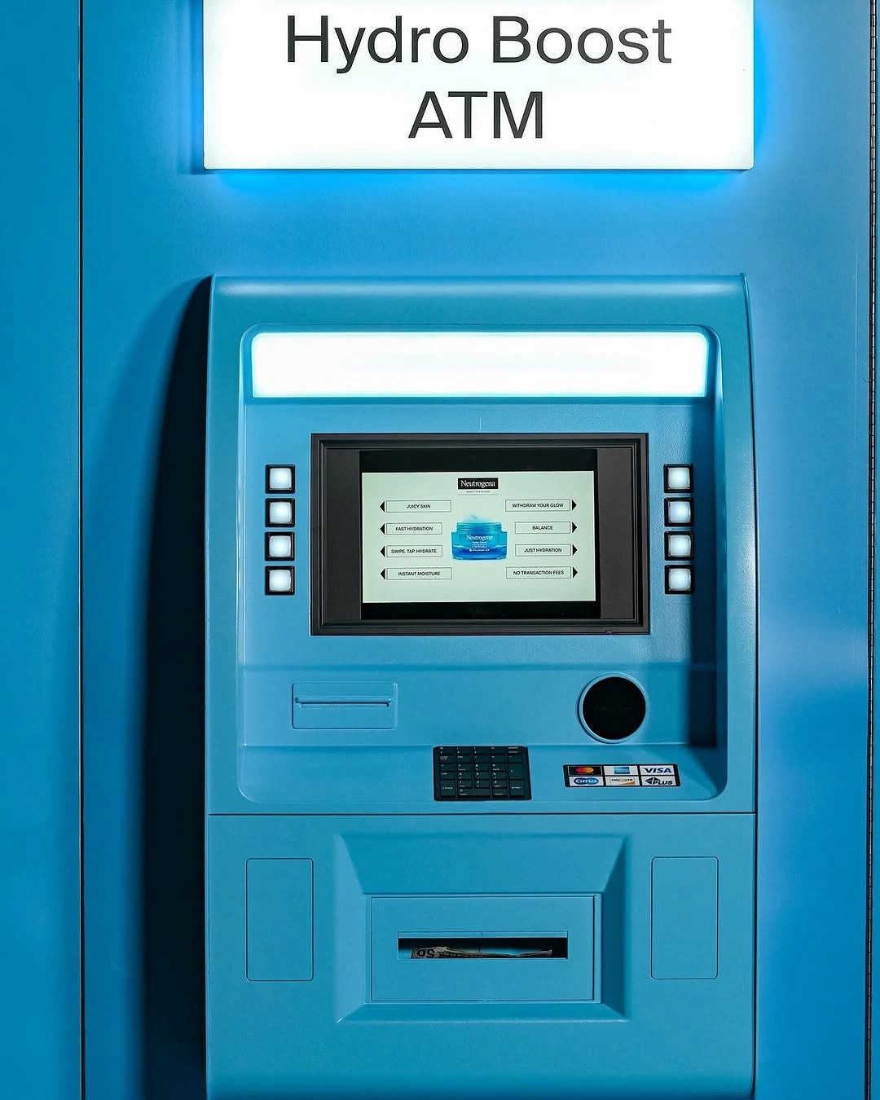
PSPJ • JAVA PROJECT
ATM
TRANSACTION
SYSTEM
A console-based Java simulation for secure PIN access,
balance enquiry and cash withdrawal.
JAVA • ARRAYS • METHODS
Team No: ________ Name / Roll No: __________________
Date: ______________

Slide 2
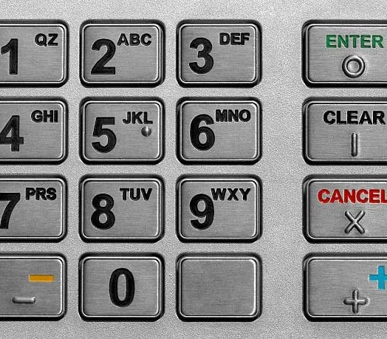
Abstract
Project overview
This project models the basic flow of an ATM session using Java.
• Authenticates the user with a PIN.
• Allows balance enquiry and cash withdrawal.
• Validates withdrawal amount and available balance.
• Calculates banknote denominations for dispensing.
• Displays a simple transaction history.
Educational simulation only — not connected to a real bank or ATM.
02 / 12

Slide 3
Understanding the Problem
Inputs → processing → outputs
INPUTS
PROCESS
OUTPUTS
PIN, menu choice,
withdrawal amount
Authenticate, validate,
calculate notes, update balance
Balance, denial message,
note breakdown, history
Rules implemented
• Three incorrect PIN attempts block the session.
• Withdrawal must be positive, ≤ ₹20,000, within balance and in multiples of ₹100.
• Successful withdrawal reduces the displayed balance.
03 / 12

Slide 4
CO1 • Problem-Solving Foundations
Breaking the ATM task into clear steps
01
Read PIN
02
Verify PIN
03
Show menu
04
Validate choice
05
Process request
06
Display result
The program follows a logical sequence: input → decision → action → output.
04 / 12

Slide 5
CO2 • Selection & Iteration
Conditions and loops control the session
SELECTION
ITERATION
• if / else checks whether the PIN is correct.
• Withdrawal conditions reject invalid amounts.
• Menu choices select balance, withdrawal, statement or exit.
• while loop allows up to three PIN attempts.
• Main menu repeats until the user chooses Exit.
• for loop breaks the amount into available note denominations.
05 / 12

Slide 6
CO3 • Methods & Arrays
Reusable logic and note denominations
METHODS
NOTE CALCULATION EXAMPLE
• authenticate(pin) — checks the PIN.
• displayMenu() — prints available actions.
• withdraw(amount, balance) — validates, dispenses and returns updated balance.
• printStatement() — prints stored withdrawal amounts.
₹2,800
₹2,000 × 1
₹500 × 1
₹200 × 1
₹100 × 1
NOTES = {2000, 500, 200, 100}
06 / 12

Slide 7

CO4 • Program Structure & Robustness
Current design and improvement areas
What the current code demonstrates
• AtmTransaction class groups the program logic.
• Static methods share PIN, limit, denominations and history data.
• The balance is maintained during the current run.
Important limitations
• PIN is hardcoded; no exception handling or persistent storage.
• History array length is 3, but the guard checks < 5 — fix before demo.
07 / 12

Slide 8

CO5 • Data & Console Interaction
How the user interacts with the program
SAMPLE CONSOLE FLOW
Enter PIN: 1234
1.Balance 2.Withdraw 4.Statement 5.Exit
Choice: 2
Amount: 2800
Dispensing:
2000 x 1
500 x 1
200 x 1
100 x 1
The current version uses Scanner and console text; it does not read or write transaction files.
08 / 12

Slide 9
CO6 • Testing & Data Handling
Test cases for the current implementation
Correct PIN
Access granted
3 wrong PINs
Card Blocked
Amount = 0 / > balance
Denied
Amount not multiple of 100
Denied
Valid amount
Notes displayed; balance reduced
Advanced collections, streams and file handling are not implemented in this code; this slide records test behaviour and scope.
09 / 12

Slide 10
Conclusion
What the project demonstrates
• Implements a simple PIN-based ATM session.
• Applies conditions, loops, methods and arrays.
• Validates withdrawals and calculates note denominations.
• Shows how small validation bugs can affect reliability.
Future scope
Fix history bounds • Track cumulative daily withdrawals • Add exception handling • Store transactions securely • Replace hardcoded PIN
10 / 12

Slide 11
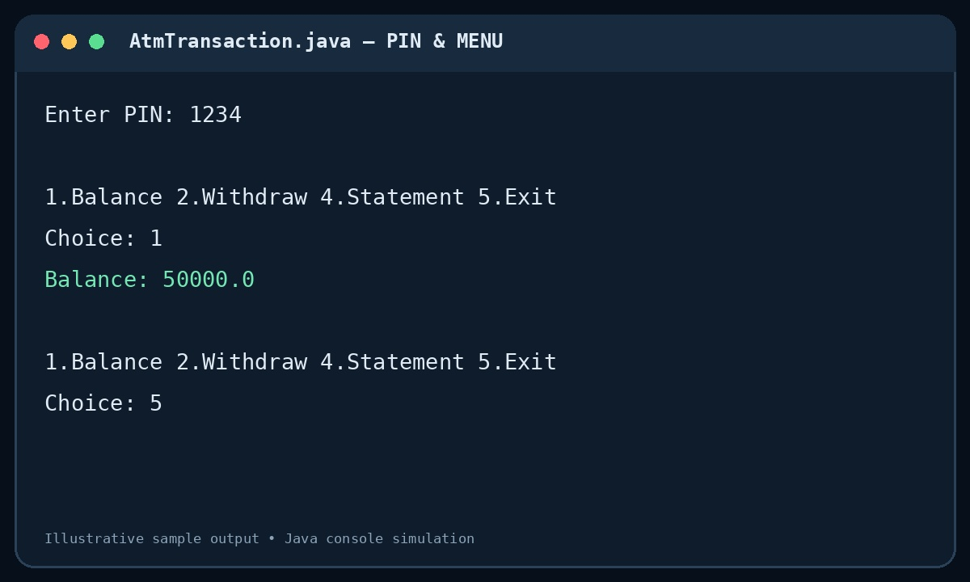
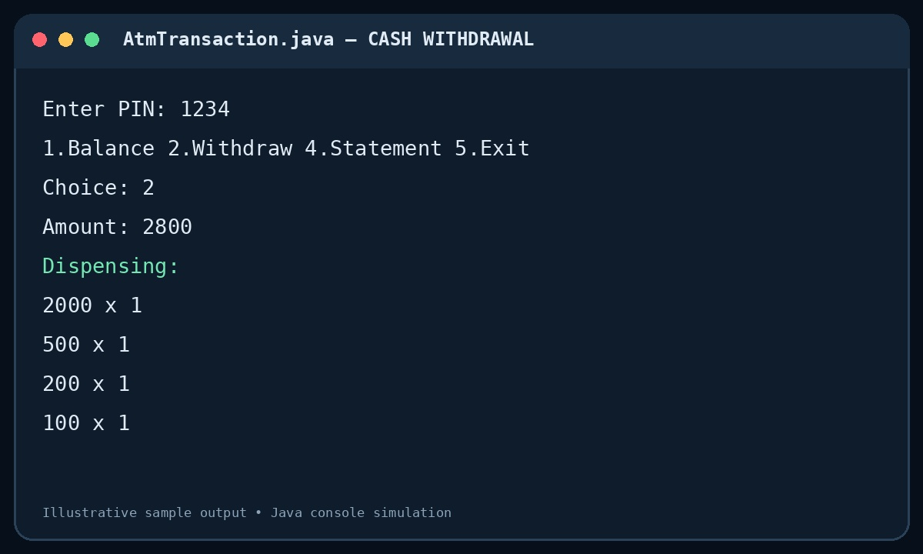
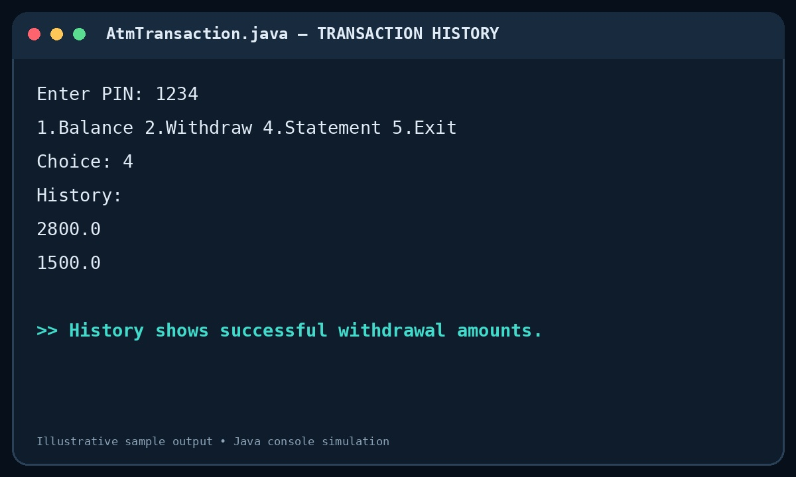
Program Screenshots
Sample console outputs for the main ATM workflows
01 PIN & BALANCE
02 WITHDRAWAL
03 STATEMENT
Shows PIN acceptance and balance enquiry.
Shows note breakdown for ₹2,800.
Shows saved withdrawal amounts.
Note: these are illustrative sample outputs based on the provided Java code; replace with direct IDE screenshots if your evaluator requires actual execution evidence.
11 / 12

Slide 12
Geo-Tagged Photo & GitHub
Final project evidence
GEO-TAGGED PROJECT PHOTO
TEAM GITHUB PROFILES
github.com/unnamramya
Insert team / lab photo
with location tag
github.com/LasyaPriyaSrirangam
Add source code, README, test cases and screenshots.
Use a real project-related photo; don't use a stock image as proof.
Verify the repository is public or accessible to your evaluator.
12 / 12

